Slide 1
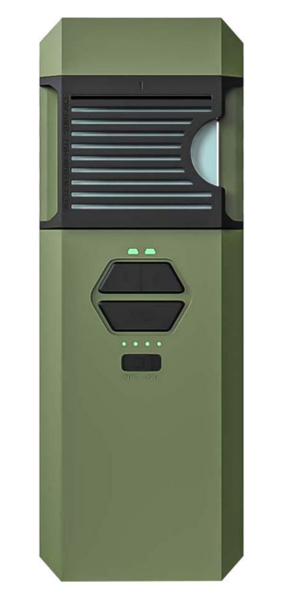
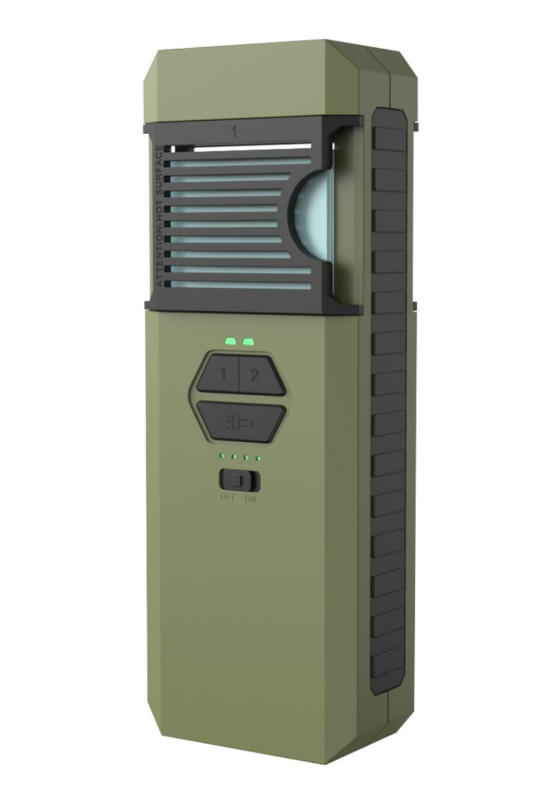
Outdoor Electronic Mosquito Repeller
Model: MR9000
Material: The shell is made of nylon + fiberglass, with high strength and heat resistance, capable of withstanding impacts and abrasion, ensuring stable operation.
Working hours: single sides 12h, double sides 5h
Battery capacity: 2x4500mAh 21700, long-lasting battery life
Waterproof grade: IP5 (but real Featuring nano- coating on all charging ports,can put into water 30mins)
Heating plate: 2pcs of MCH (Uniform heating, can reach the standard temperature)
Heating temperature: 160℃
Power Input: 5V/2A
Rated Power: 11W
Output Voltage: 4.2V/5A
Rated Current: 5A
Waterproof Rate: IP5
3-in-1 Functions: Mosquito repeller, flashlight, andpower bank (capable of charging 4 iPhones).
Portable and compact design: only 263.7g andequipped with hanging ropes for easy carrying. Dul-sided Heating, sparete control each side
Max compatible mosquito Repellent tablet size:4.85*3.45x0.2cm
Effective range:3-9 square meters, starting to take effect within 15 minutes
Suitable scenario: Camping,hiking, climbing,fishing outdoor
Item no.: MR9000
Product size: 14.6x5.4x3cm
QTY/Color Box Size: 1pc product /1pc color box
Color Box Size: 20.3x9x5cm (hanger hole on the top)
Inner carton size: 20.3x9x5cm / 6pcs color box in 1 inner carton
Outer Carton Size:28x36x33cm / 6pcs inner carton in 1 outer carton )
NW of product:0.366kgs
GW of 1 carton: 13.5kgs
20GP: 33768Pcs product
40GP: 68292Pcs product
40HQ: 78912Pcs product
45HQ: 89280Pcs product

Slide 2
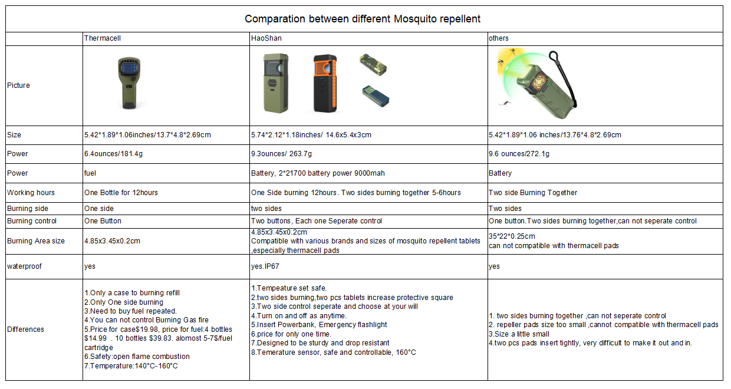

Slide 3
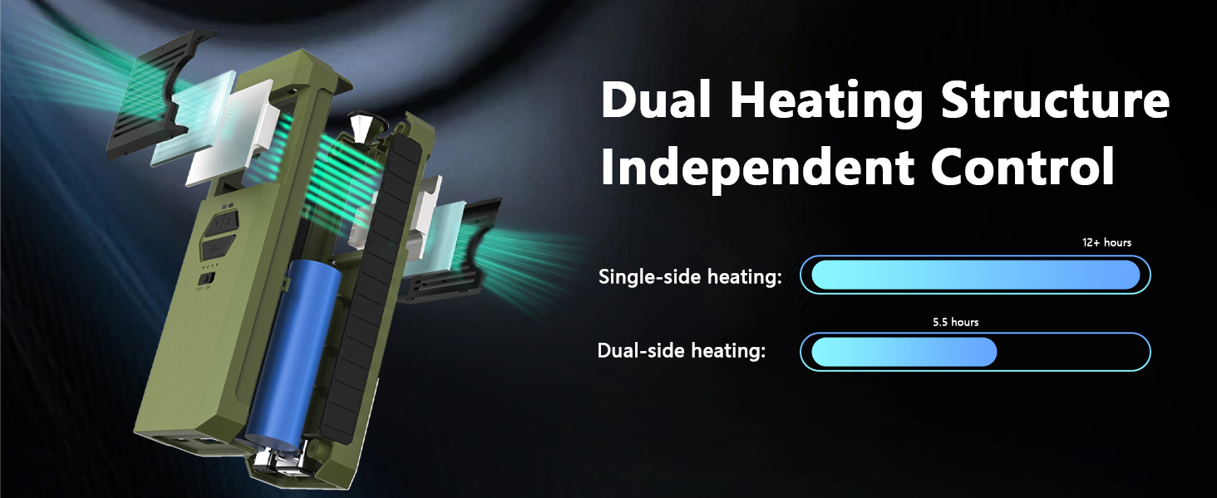
Dual side heating technology
Heating pricinple:Dual side indivisual heating
It adopt two sides indivisual control heating way. Each side can be controlled seperately by customer using choose. It use 2 pcs seperated MCH Ceramic heating sheet to make the heating teperature reach to 160degree. So that it can make the tablet totally burned. No open flame,Safe and environmentally friendly, rechargeable
Each side has a switch control
When using a single side,12+h of protection
When using both sides,Gain greater protection range,5 ½ h of protection.

Slide 4
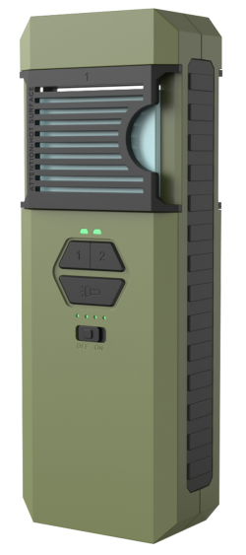
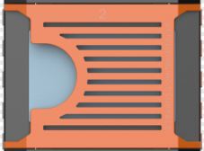
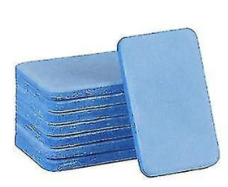
Product Advantage
Tablet size: 4.85x3.45x0.2cm
Compatible with all brands and sizes of mosquito repellent tablets

Slide 5
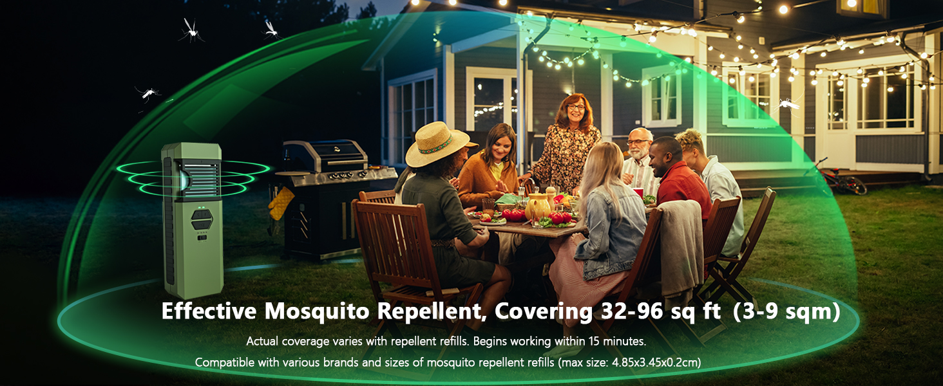
Effective range
1.Single heating: it can reach to 3-5 square meters.
2.Dual side heating:it can reach to 6- 9 square meters.

Slide 6
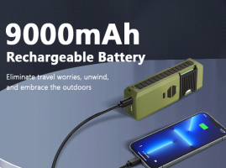
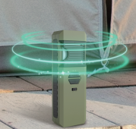
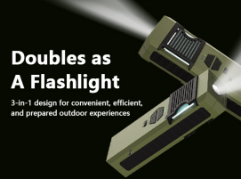

Multi-function
Multi-function Three in one:Mosquito Repellent + Lighting + Power Bank
Inside with 9000 mah battery, real capacity, you can make it with 4 iPhones
Ensuring mosquito protection,power supply and illuminatio whenever you need it
Mosiquito repeller
Enjoy extended periods of mosquito protection
Flashlights
Functioning as an emergency light for camping nights

Slide 7
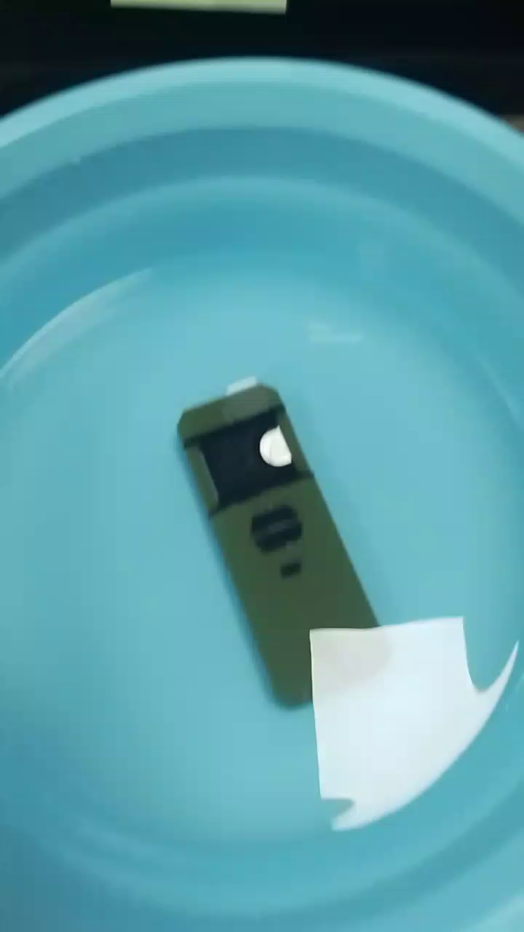
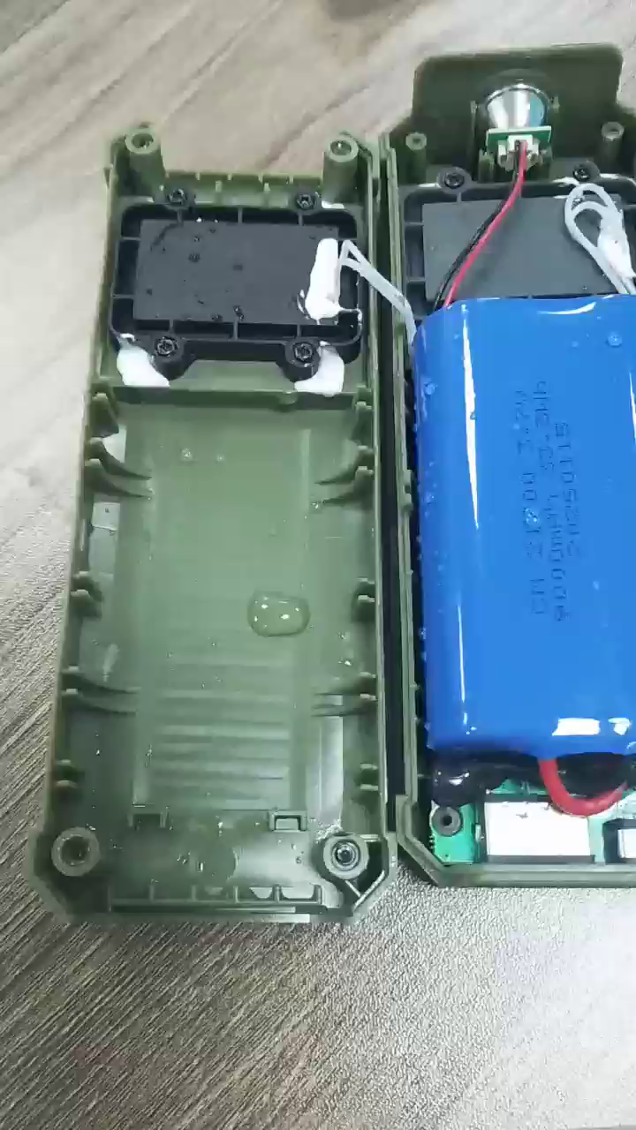
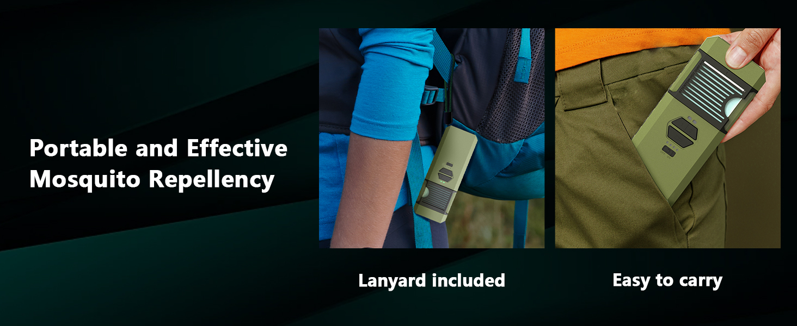
Portable design
The apperance design it to be portable, sturdy and durable, with IP5 waterproofing. The built-in PCBA board has a nano-coating and can be soaked in water for more than 30 minutes.
Drop-resistant construction, it can withstand accidental drops and impacts, minimizing the risk of damage
Portable size:5.7in X2.1in,the mini size allows you to easily carry it anywhere
This ensures dependable performance even in wet or rainy conditions

Slide 8
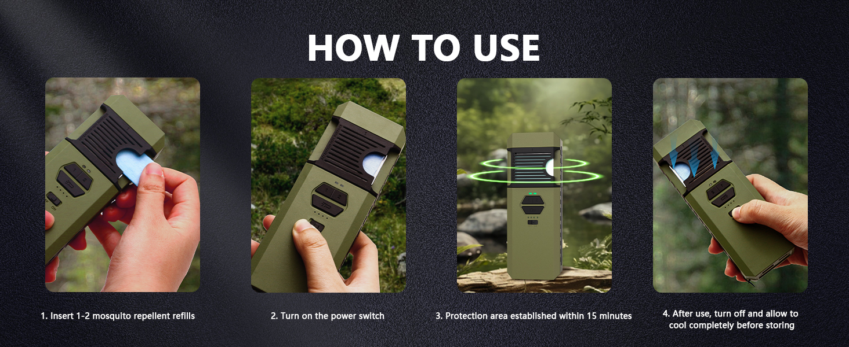
Easy to use

Slide 9
Question
1.How to insert/replace the tablets?
* Use the new piece to put out the old one from right side.
* Insert tablet push in and out from right side, so won't burn your hand.
2. What is the user population and working principle?
* All ages.
Many peoples asked whether it is safe for kids and baby, it depands on the tablets(ours has the domestic test report) , you also can buy famouse/certificated tablets in your country to heat if you are worried. Our mosquito repellent is a tool for placing tablets.

Slide 10
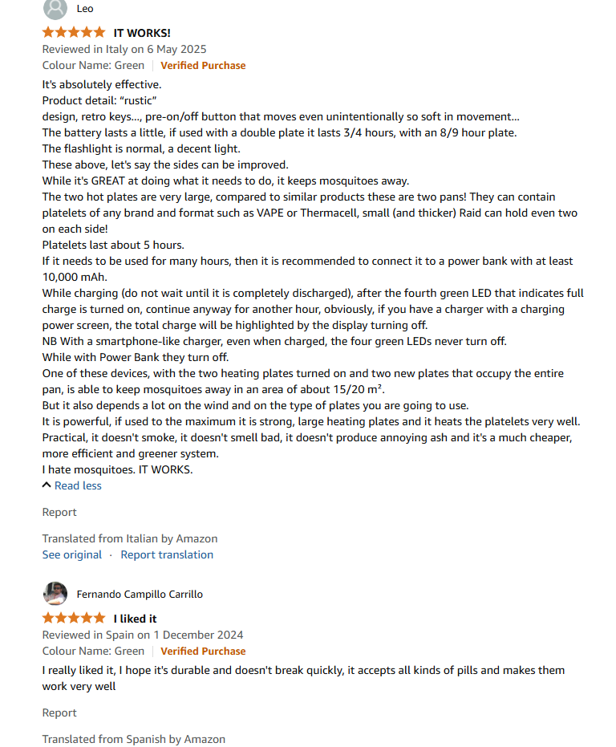
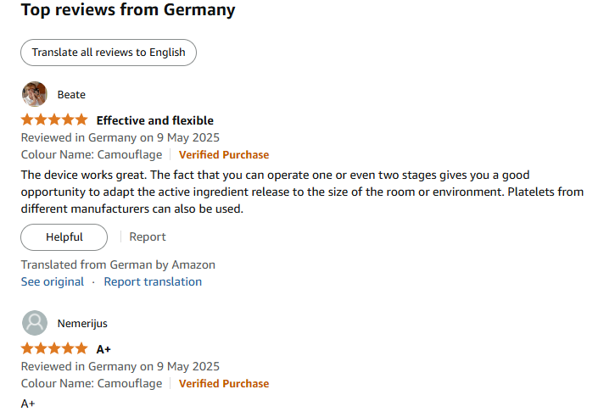
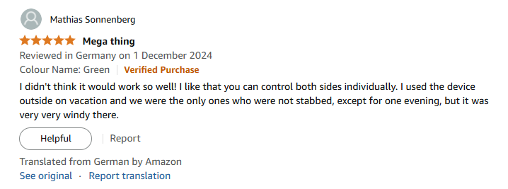
5 Stars Reviews

Slide 11
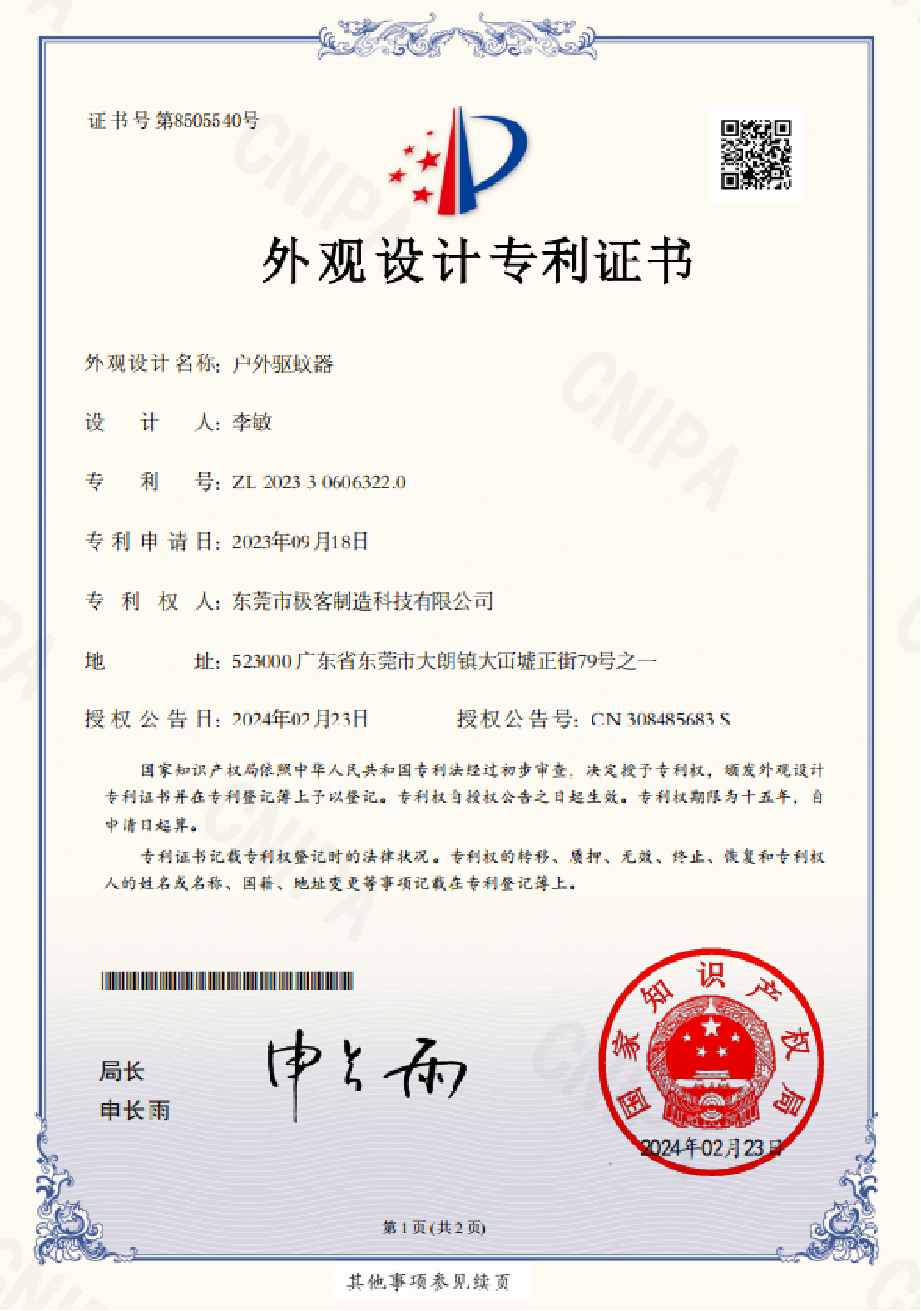
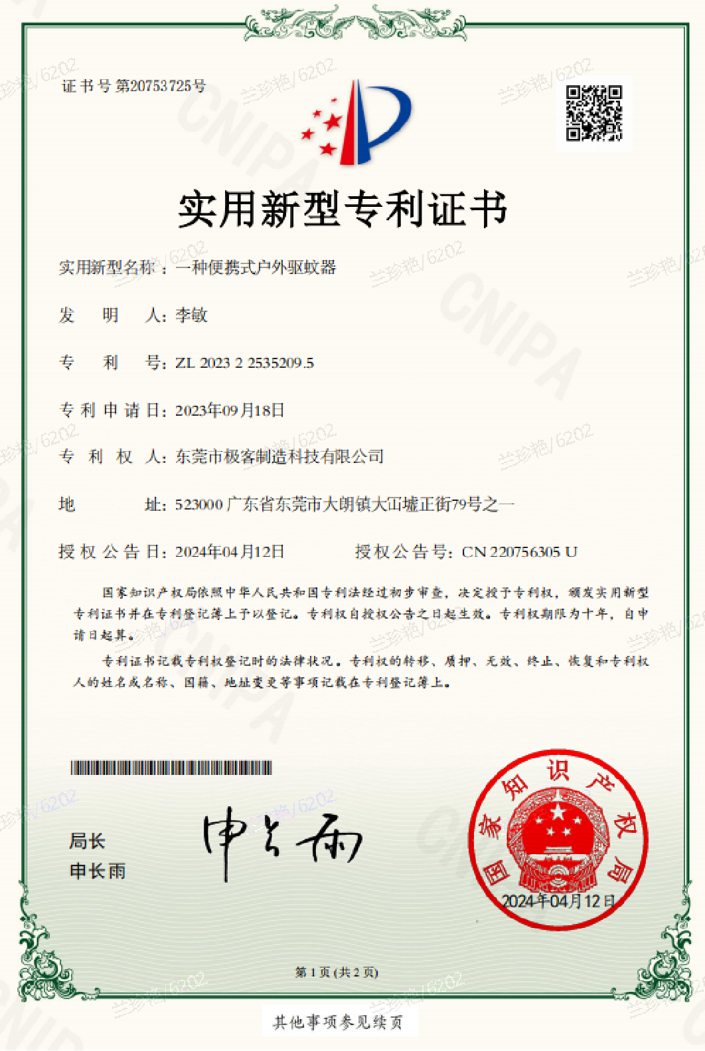
Patent
Design Patent
utility model patent

Slide 12
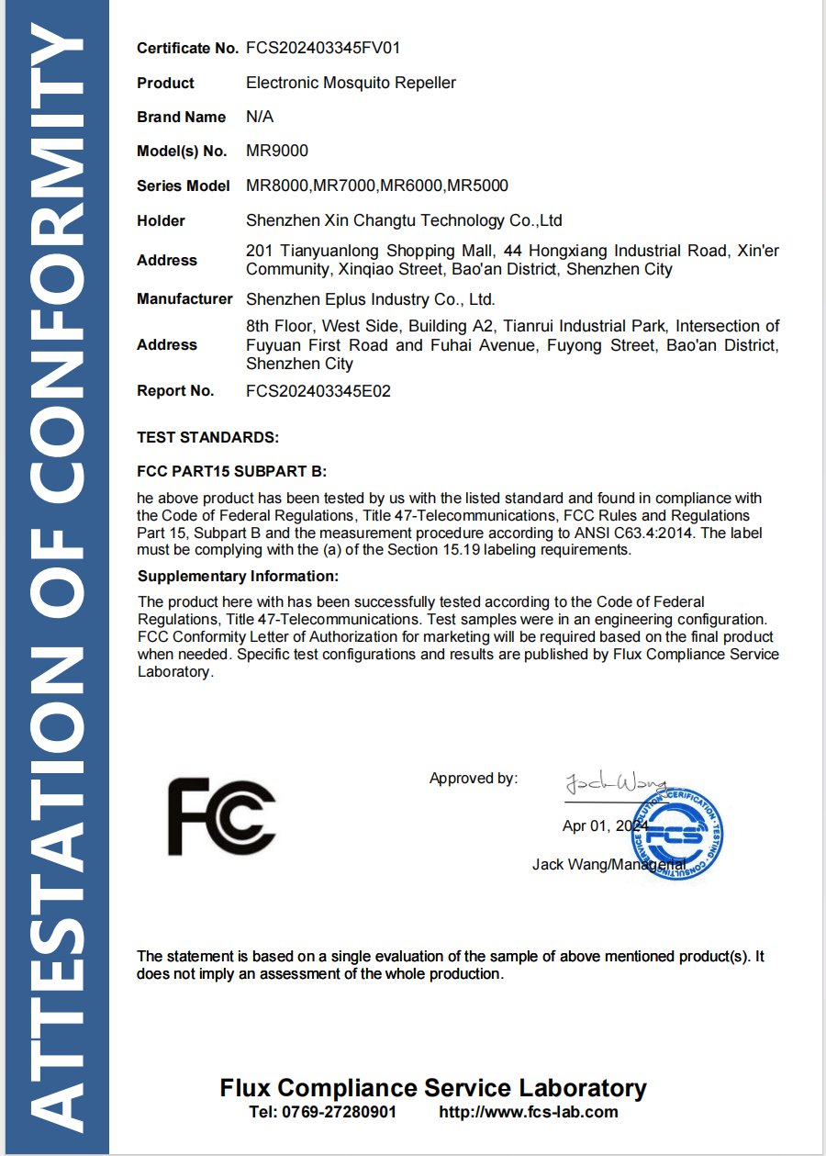
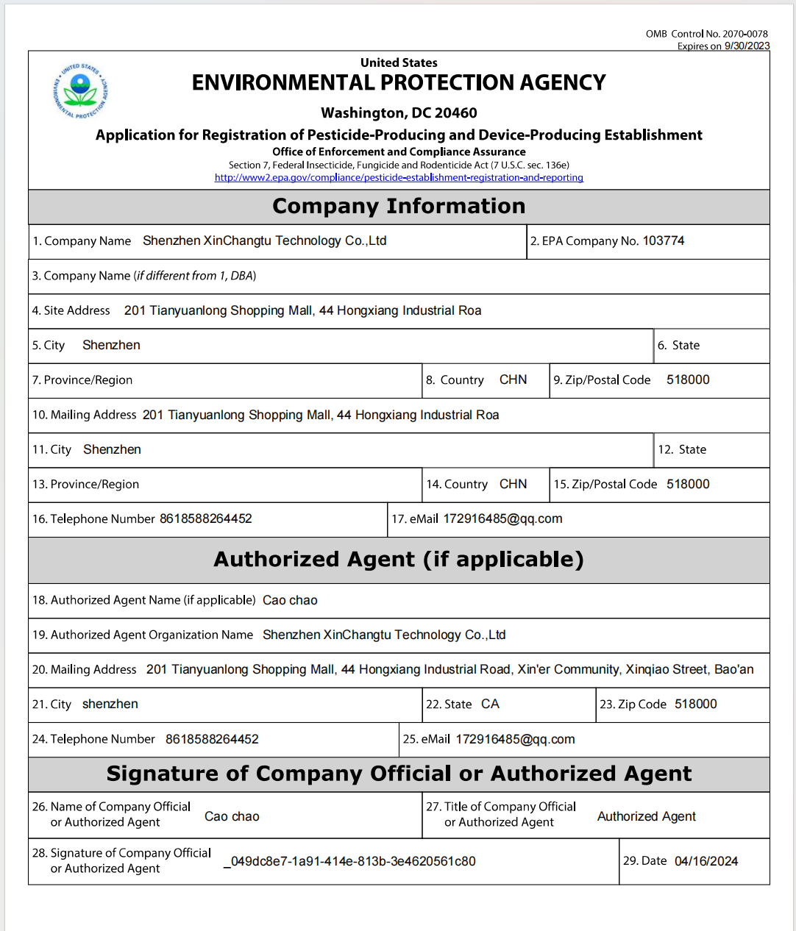
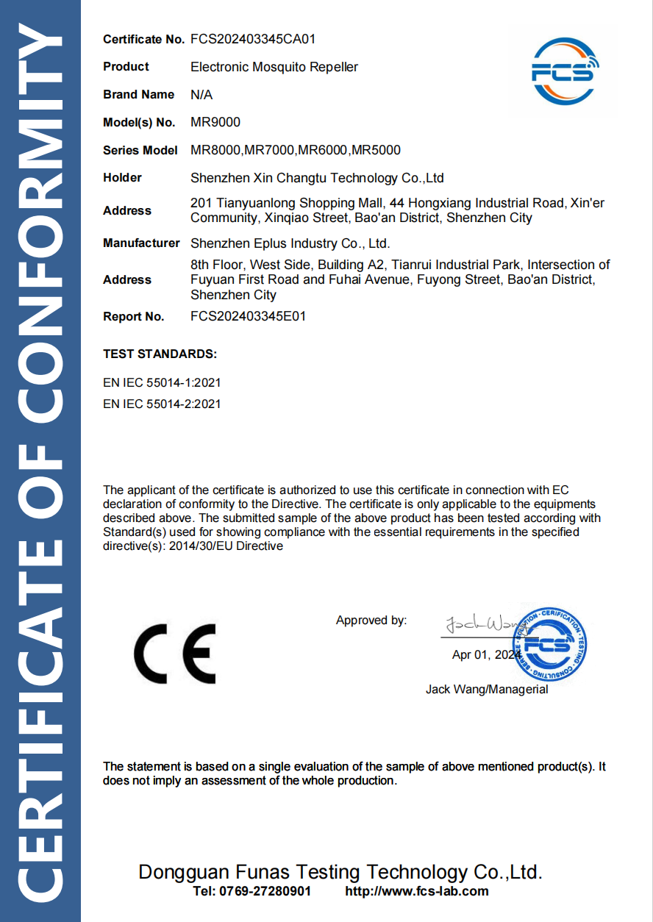
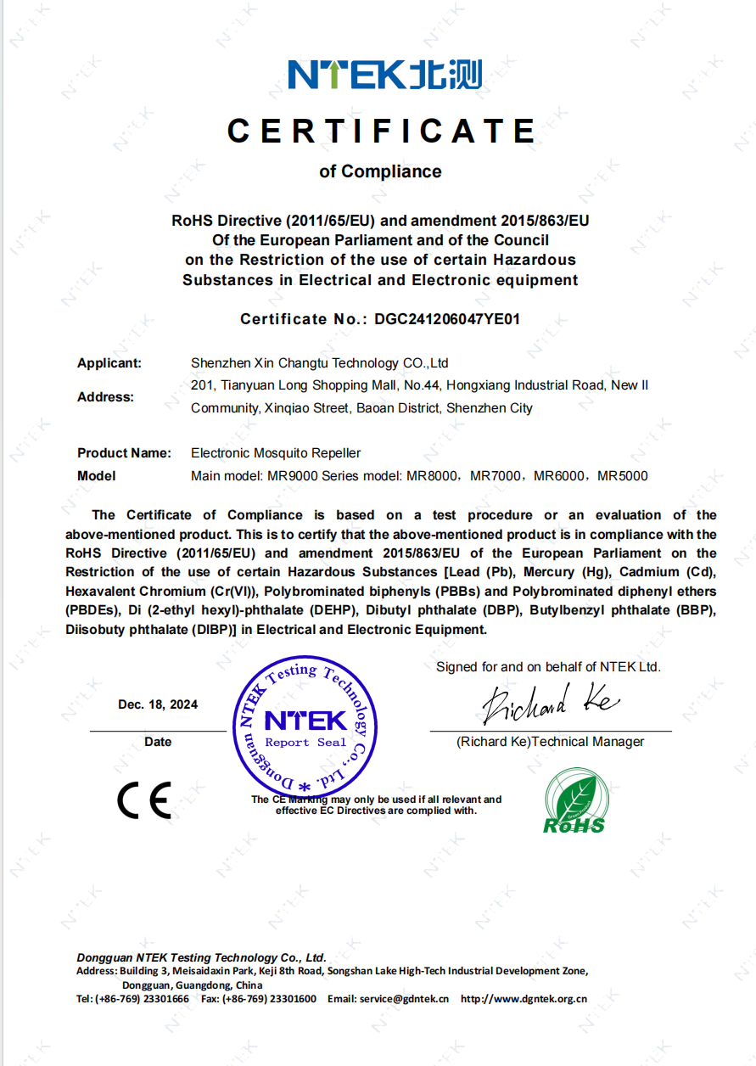
Certification
CE
ROHS
FCC
EPA-USA

Slide 13
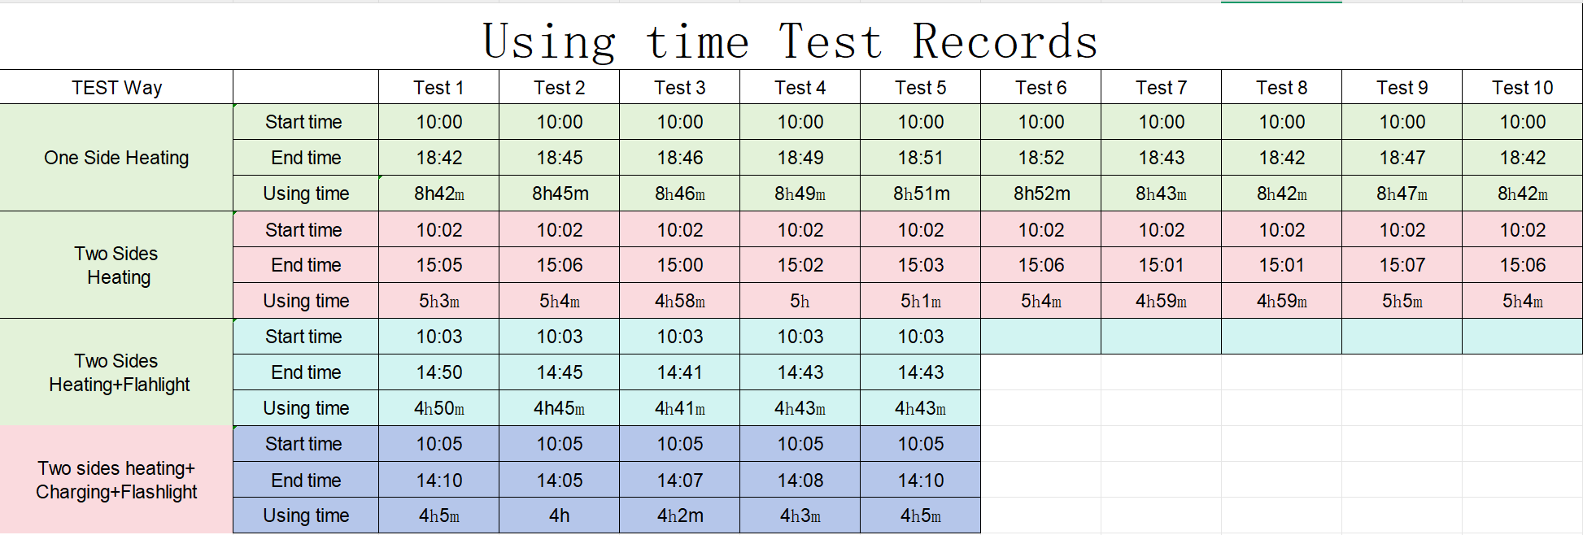
Test records

